Slide 1
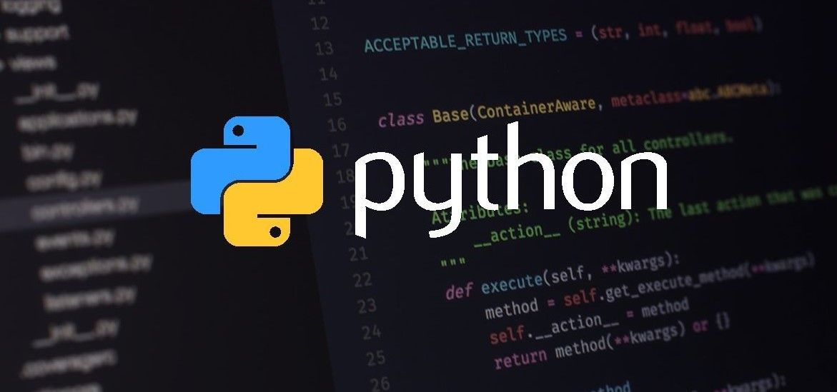
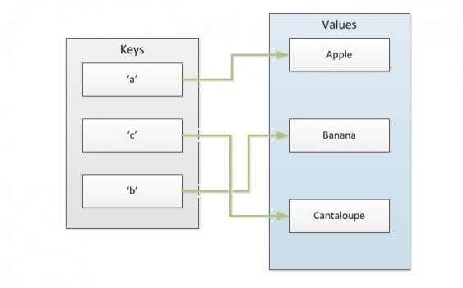
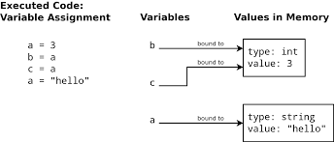
Seminar on Variables and Dictionaries in Python

Slide 2
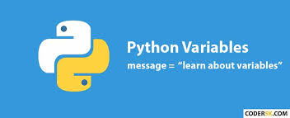
Variables
Table of Contents
Variable Assignment
Variable Types in Python
Object References
Object Identity
Variable Names
Reserved Words (Keywords)

Slide 3
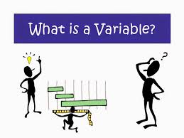
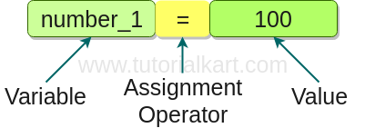
Variable Assignment
Variables are containers for storing data values.
A variable is created the moment you first assign a value to it.
Variables do not need to be declared with any particular type and can even change type after they have been set.
E.g.,
x = 4 ------# x is of type int x = "Sally" ---# x is now of type str print(x)
Output = Sally

Slide 4
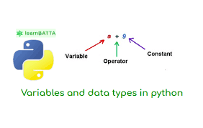
Variable Types in Python
A variable is initially declared to have a specific data type, and any value assigned to it during its lifetime must always have that type. But this restriction is not applicable in python.
E.g., val = 4.5 -- #type is float
print(val)
output = 4.5
val = “I am Nandan” #here we changed the type as string
print(val)
output = I am Nandan
If we change the type the python will replace the container value. In the above case it will change from float to string.

Slide 5
Object References
Python is a highly object-oriented language. In fact, virtually every item of data in a Python program is an object of a specific type or class.
E.g, print(45)
print(type(45))
output = 45
<class _int>
When presented with the statement print(300), the interpreter does the following:
Creates an integer object
Gives it the value 45
Displays it to the output
You can see that an integer object is created using the built-in type() function

Slide 6
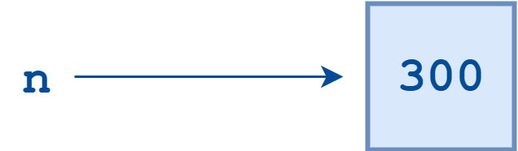
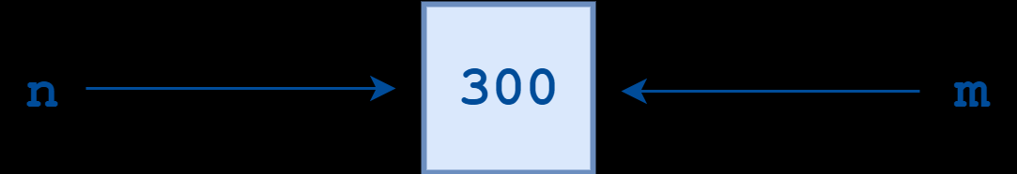
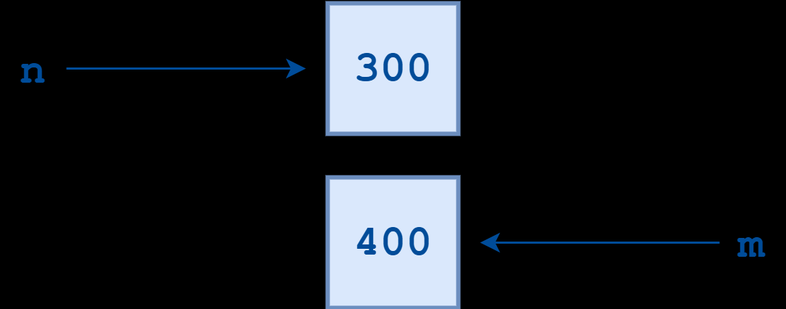
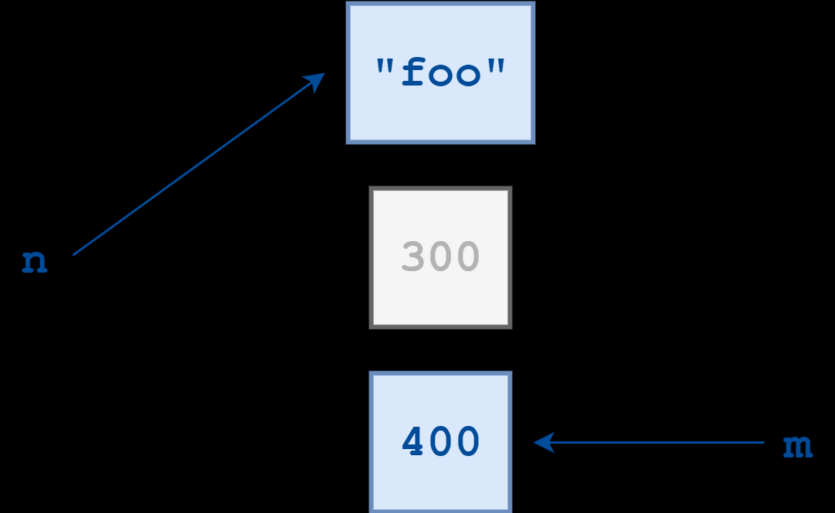
E.g.,
n = 300
m = n
m = 400
n = “foo”

Slide 7
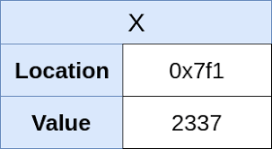
Object Identity
In Python, every object that is created is given a number that uniquely identifies it.
The built-in Python function id() returns an object’s integer identifier. Using the id() function, you can verify that two variables indeed point to the same object.
E.g., n = 300
m = n
id(n)-- 60127840
id(m)– 60127840
m = 400
id(m) --60127872

Slide 8
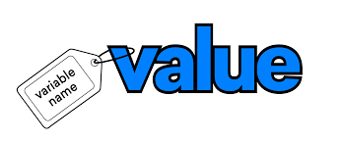
Variable Names
A variable can have a short name (like x and y) or a more descriptive name (age, carname, total_volume).
Rules for Python variables:
A variable name must start with a letter or the underscore character
A variable name cannot start with a number
A variable name can only contain alpha-numeric characters and underscores (A-z, 0-9, and _ )
Variable names are case-sensitive (age, Age and AGE are three different variables)
E.g., name = “Nandan”
has_w3 = True
x = 5
i = 4.5
22nan_1 = “School” -→ SyntaxError: invalid token

Slide 9
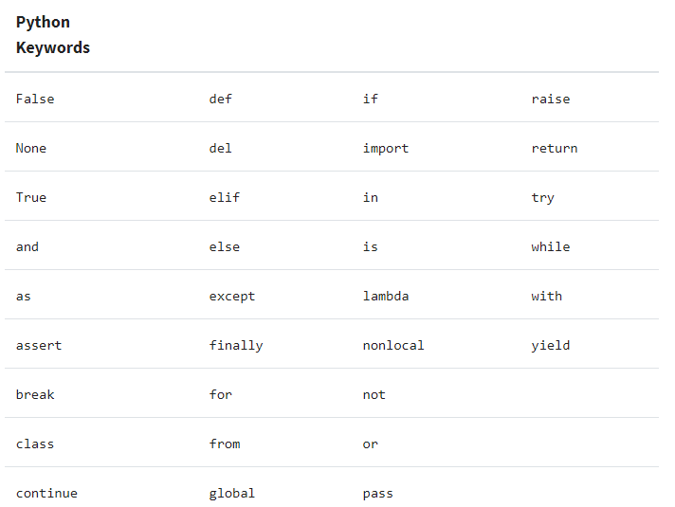
Reserved Words (Keywords)
The Python language reserves a small set of keywords that designate special language functionality. No object can have the same name as a reserved word.

Slide 10
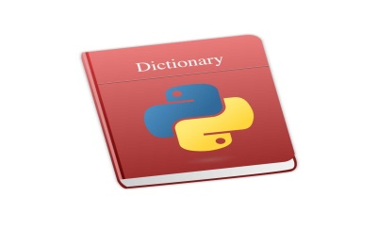
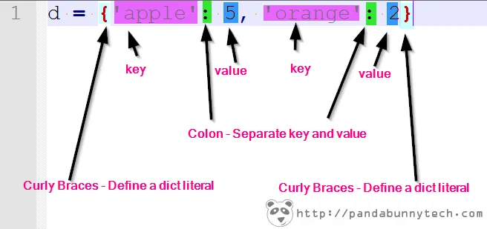
Dictionaries
Table of Contents:
What Is a Dictionary in Python?
Operations in dictionaries
Methods for Dictionaries in Python

Slide 11
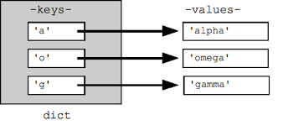
What Is a Dictionary in Python?
Dictionaries and lists share the following characteristics:
Properties of dictionaries:
It is a key value pair enclosed in curly brackets{:}
Ordering and indexing is not possible
Its mutable, we can change/update the dictionaries
Duplicate keys are not possible but duplicate values are possible.
E.g., dic1 = {"Nandan":"Python","Manu":"SAP MM","Suchi":"Java"}

Slide 12
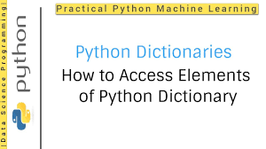
Operations in Dictionaries
Accessing Items:
We can access the items of a dictionary by referring to its key name, inside square brackets:
E.g., x = thisdict["model"]
Length of Dictionary:
To determine how many items (key-value pairs) a dictionary has, use the len() method.
E.g, thisdict = {"brand": "Ford","model": "Mustang","year": 1964}
print(len(thisdict))

Slide 13
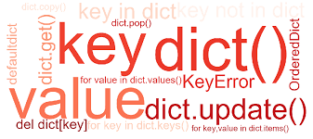
Methods in Dictionaries
clear() -
Removes all the elements from the dictionary
E.g.,
dic1 = {"Nandan":"Python","Manu":"SAP MM","Suchi":"Java"}
dic1.clear()
print(dic1)
output = {}
copy()-
Returns a copy of the dictionary
E.g.,
dic1 = {"Nandan":"Python","Manu":"SAP MM","Suchi":"Java"}
dic2 = dic1.copy()
print(dic2)
output = {"Nandan":"Python","Manu":"SAP MM","Suchi":"Java"}

Slide 14
Methods in Dictionaries
fromkeys() -
Returns a dictionary with the specified keys and value
E.g.,
key = {'Nandan','Manu','Suchi’)
value = 'python'
dic1 = dict.fromkeys(key,value)
print(dic1)
output = {'Nandan': 'python', 'Manu': 'python', 'Suchi': 'python'}
get() -
Returns the value of the specified key
E.g.,
dic1 = {"Nandan":"Python","Manu":"SAP MM","Suchi":"Java"}
dic2 = dic1.get("Nandan")
print(dic2)
output= Python

Slide 15
Methods in Dictionaries
items() -
Returns a list containing a tuple for each key value pair
E.g.,
dic1 = {"Nandan":"Python","Manu":"SAP MM","Suchi":"Java"}
dic2 = dic1.items()
print(dic2)
Output = dict_items([('Nandan', 'Python'), ('Manu', 'SAP MM'), ('Suchi', 'Java')])
keys() -
Returns a list containing the dictionary's keys
E.g.,
dic1 = {"Nandan":"Python","Manu":"SAP MM","Suchi":"Java"}
dic2 = dic1.keys()
print(dic2)
Output = dict_keys(['Nandan', 'Manu', 'Suchi'])'''

Slide 16
Methods in Dictionaries
values() -
Returns a list of all the values in the dictionary
E.g.,
dic1 = {"Nandan":"Python","Manu":"SAP MM","Suchi":"Java"}
dic2 = dic1.values()
print(dic2)
output = dict_values(['Python', 'SAP MM', 'Java'])
pop() -
Removes the element with the specified key
E.g.,
dic1 = {"Nandan":"Python","Manu":"SAP MM","Suchi":"Java"}
dic1.pop("Nandan")
print(dic1)
output = {"Manu":"SAP MM","Suchi":"Java"}

Slide 17
Methods in Dictionaries
popitem() -
Removes the last inserted key-value pair
E.g.,
dic1 = {"Nandan":"Python","Manu":"SAP MM","Suchi":"Java"}
dic1.popitem()
print(dic1)
output = {"Nandan":"Python","Manu":"SAP MM"}
setdefault() -
Returns the value of the specified key. If the key does not exist: insert the key, with the specified value
E.g.,
dic1 = {"Nandan":"Python","Manu":"SAP MM","Suchi":"Java"}
dic2 = dic1.setdefault("Akshay","Big data")
print(dic2)
output = Big data

Slide 18


